Slide 1






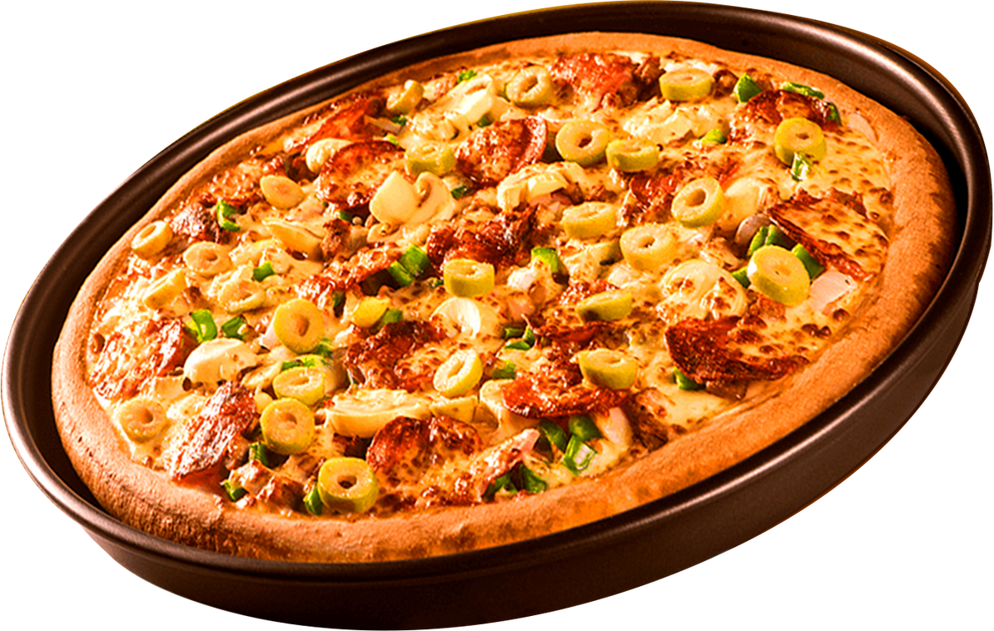
PIZZA SALES
DATA ANALYTICS PROJECT - SQL
ANALYSIS

Slide 2
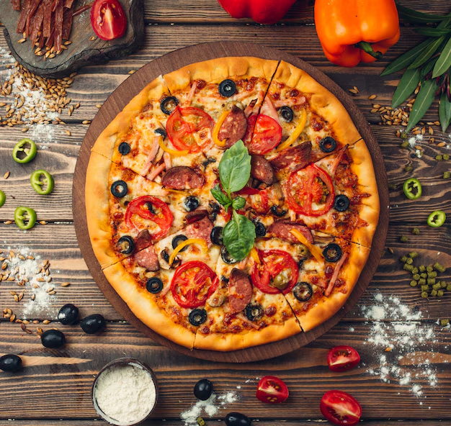
INTRODUCTION
This project focuses on analyzing pizza sales data using SQL.
The objective is to extract meaningful insights related to sales performance, revenue trends, and customer preferences by working with multiple relational tables.

Slide 3
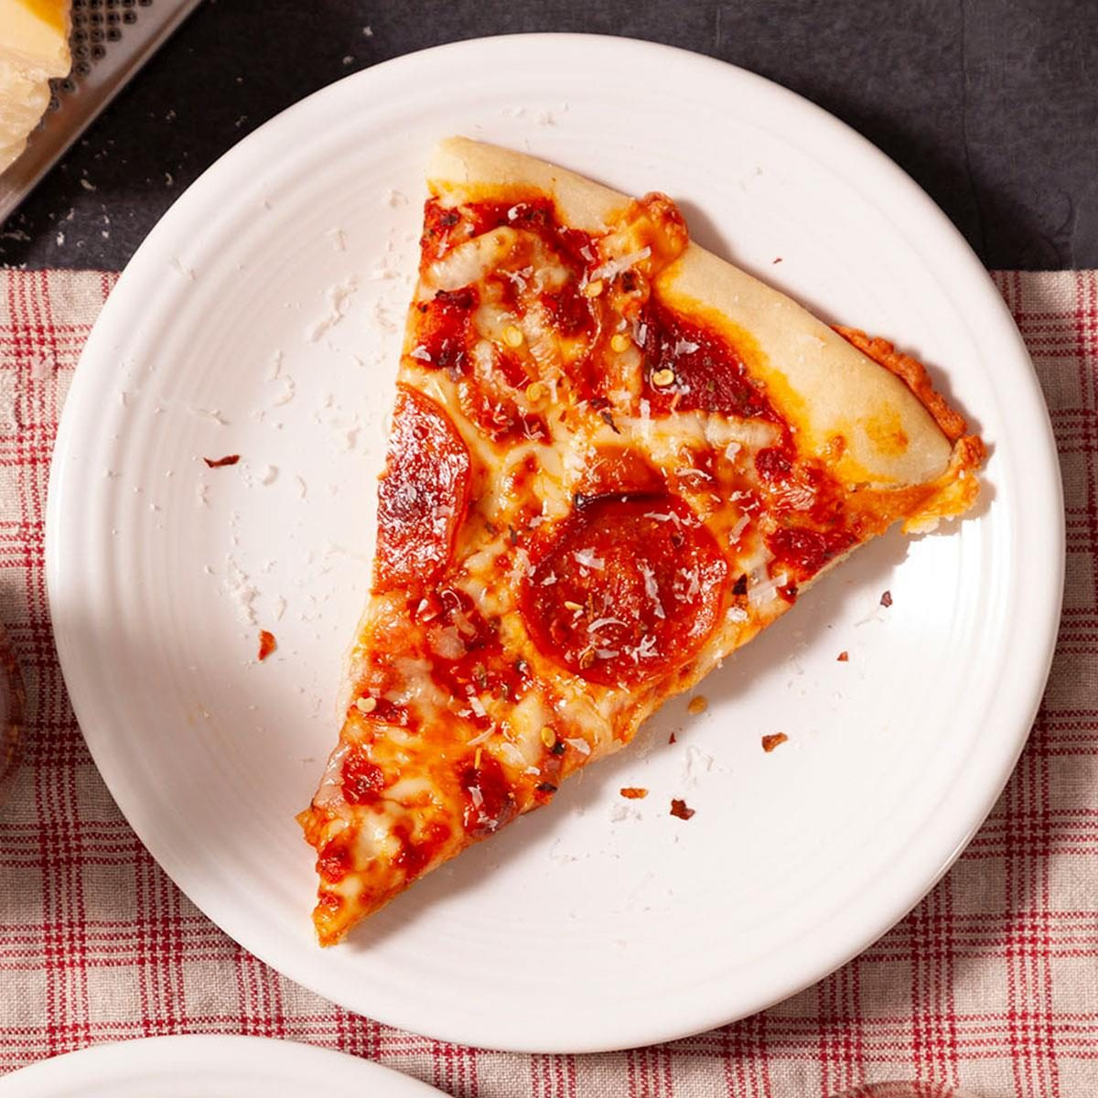
ANALYSIS QUESTIONS
Basic Analysis
Total number of orders placed
Total revenue generated
Most ordered pizza size and type
Intermediate Analysis
Category-wise sales distribution
Order trends by date and time
Average pizzas ordered per day
Advanced Analysis
Revenue contribution by pizza type
Cumulative revenue over time
Top 3 pizzas by revenue in each category

Slide 4
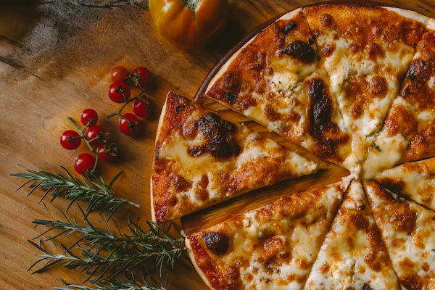
DATASET OVERVIEW
Orders – Order date and time information
Order_Details – Quantity of pizzas ordered
Pizzas – Pizza size and price details
Pizza_Types – Pizza name and category
The analysis is performed using the following tables:

Slide 5


SQL TECHNIQUES USED
Joins (INNER JOIN across multiple tables)
01
02
Aggregate Functions (SUM, COUNT, AVG)
03
GROUP BY & ORDER BY
Window Functions
RANK()
SUM() OVER()
04
05
Subqueries

Slide 6
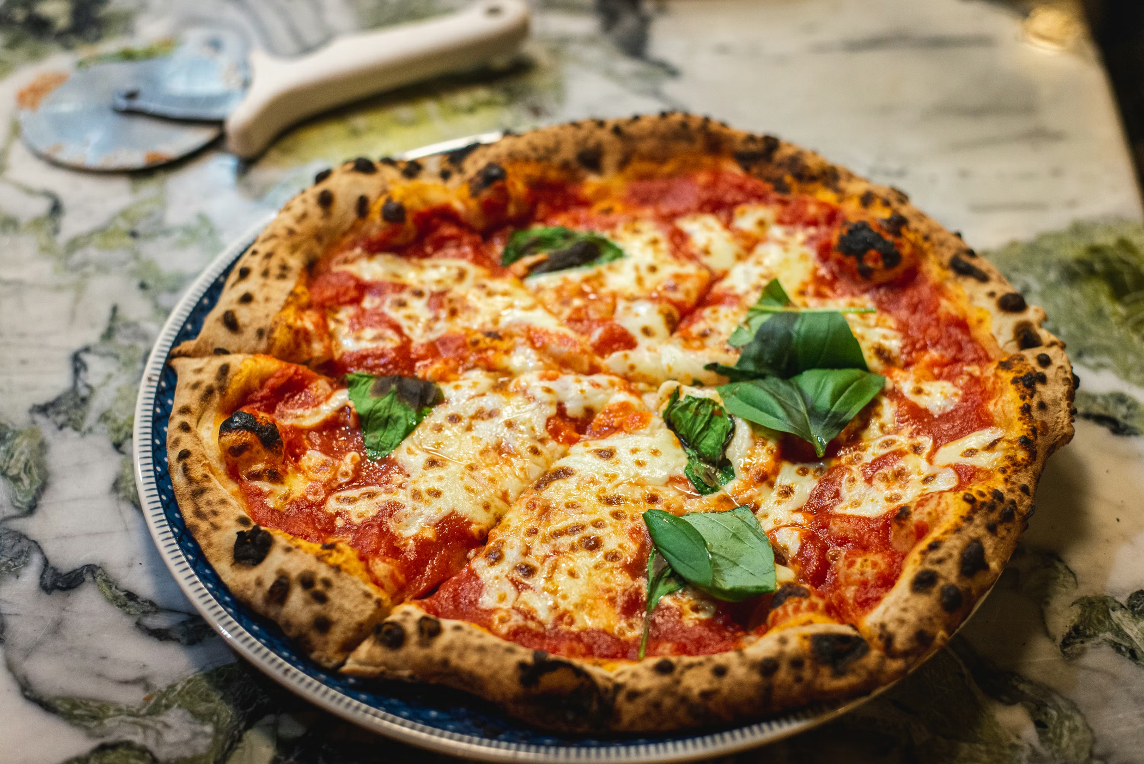
KEY INSIGHTS
A small number of pizza types contribute to a large share of total revenue
01
Certain pizza sizes are consistently more popular than others
02
Sales show clear patterns by date and time, indicating peak demand periods
03
Category-wise analysis reveals uneven revenue distribution
04
05
Cumulative revenue analysis highlights steady growth over time

Slide 7
TOTAL NUMBER OF ORDERS.
Query:
Output:
SELECT
COUNT(order_id) AS total_orders
FROM
orders;
total_orders
21350
A total of 21,350 orders were placed, indicating strong customer demand and providing a baseline for overall sales performance analysis.

Slide 8
TOTAL Revenue generated.
Query:
Output:
SELECT
ROUND(SUM(order_details.quantity * pizzas.price),
2) AS total_revenue
FROM
order_details
JOIN
pizzas ON pizzas.pizza_id = order_details.pizza_id
total_revenue
$817,860
Total revenue of $817,860 indicates strong overall sales performance and reflects effective conversion of customer demand into revenue.

Slide 9
Highest priced pizza.
Query:
Output:
SELECT
pizza_types.name, pizzas.price
FROM
pizza_types
JOIN
pizzas ON pizza_types.pizza_type_id = pizzas.pizza_type_id
ORDER BY pizzas.price DESC
LIMIT 1;
The Greek Pizza
$35.95
The Greek Pizza is the highest-priced item at $35.95, indicating a premium offering within the menu.

Slide 10
MOST COMMON PIZZA SIZE ORDERED.
Query:
Output:
SELECT
pizzas.size,
COUNT(order_details.order_details_id) AS order_count
FROM
pizzas
JOIN
order_details ON pizzas.pizza_id = order_details.pizza_id
GROUP BY pizzas.size
ORDER BY order_count DESC;
size | Order_count
Large | 18526
Mediam | 15385
Small | 14137
Large-sized pizzas are the most commonly ordered, indicating a strong customer preference for larger portions.

Slide 11
TOP 5 MOST ORDERED PIZZA.
Query:
Output:
SELECT
pizza_types.name, SUM(order_details.quantity) AS quantity
FROM
pizza_types
JOIN
pizzas ON pizza_types.pizza_type_id = pizzas.pizza_type_id
JOIN
order_details ON order_details.pizza_id = pizzas.pizza_id
GROUP BY pizza_types.name
ORDER BY quantity DESC
LIMIT 5;
name | Quantity
The Classic Deluxe Pizza | 2453
The Barbecue Chicken Pizza | 2432
The Hawaiian Pizza | 2422
The Pepperoni Pizza | 2418
The Thai Chicken Pizza | 2371
The Classic Deluxe Pizza is the most frequently ordered item, highlighting strong customer preference for classic flavors.

Slide 12
CATEGORY – Wise QUANTITY ordered.
Query:
Output:
SELECT
pizza_types.category,
SUM(order_details.quantity) AS quantity
FROM
pizza_types
JOIN
pizzas ON pizza_types.pizza_type_id = pizzas.pizza_type_id
JOIN
order_details ON order_details.pizza_id = pizzas.pizza_id
GROUP BY pizza_types.category
ORDER BY quantity DESC;
category | Quantity
Classic | 14888
Supreme | 11987
Veggie | 11649
Chicken | 11050
Classic pizzas have the highest total quantity ordered, indicating strong customer preference for traditional pizza options.

Slide 13
Hourly distribution of orders.
Query:
Output:
hour | Order_count
11 | 1231
12 | 2520
13 | 2455
14 | 1472
15 | 1468
16 | 1920
27 | 2336
18 | 2399
19 | 2009
20 | 1642
21 | 1198
SELECT
HOUR(order_time) AS hour, COUNT(order_id) AS order_count
FROM
orders
GROUP BY HOUR(order_time);
Orders peak during lunch and evening hours, indicating strong demand during meal times.

Slide 14
CATEGORY-WISE PIZZA variety.
Query:
Output:
SELECT
category, COUNT(name)
FROM
pizza_types
GROUP BY category;
category | Count(name)
Chicken | 6
Classic | 8
Supreme | 9
Veggie | 9
Supreme and Veggie categories offer the widest variety, indicating a broader menu focus in these segments.

Slide 15
Average number of pizzas ordered per day.
Query:
Output:
SELECT
AVG(quantity)
FROM
(SELECT
orders.order_date, SUM(order_details.quantity) AS quantity
FROM
orders
JOIN order_details ON orders.order_id = order_details.order_id
GROUP BY orders.order_date) AS order_quantity;
AVG(quantity)
138.3739
On average, around 138 pizzas are ordered per day, indicating steady and consistent daily demand.

Slide 16
Top 3 pizzas by revenue.
Query:
Output:
SELECT
pizza_types.name,
SUM(order_details.quantity * pizzas.price) AS revenue
FROM
pizza_types
JOIN
pizzas ON pizzas.pizza_type_id = pizza_types.pizza_type_id
JOIN
order_details ON order_details.pizza_id = pizzas.pizza_id
GROUP BY pizza_types.name
ORDER BY revenue DESC
LIMIT 3;
name | revenue
Thai Chicken Pizza | $43,434.25
Barbecue Chicken Pizza | $42,768.00
California Chicken Pizza | $41,409.50
Thai Chicken Pizza generates the highest revenue, highlighting the strong performance of chicken-based pizzas.

Slide 17
REVENUE CONTRIBUTION by category.
Query:
Output:
SELECT
pizza_types.category,
ROUND(SUM(order_details.quantity * pizzas.price) / (SELECT
ROUND(SUM(order_details.quantity * pizzas.price), 2)
FROM
order_details
JOIN
pizzas ON pizzas.pizza_id = order_details.pizza_id) * 100,
2) AS revenue
FROM
pizza_types
JOIN
pizzas ON pizza_types.pizza_type_id = pizzas.pizza_type_id
JOIN
order_details ON order_details.pizza_id = pizzas.pizza_id
GROUP BY pizza_types.category
ORDER BY revenue DESC;
category | revenue
Classic | $26.91
Supreme | $25.46
Chicken | $23.96
Veggie | $23.68
The Classic category contributes the highest share of total revenue, while other categories show a fairly balanced distribution.

Slide 18
CUMULATIVE REVENUE OVER TIME.
Query:
Output:
SELECT order_date,
SUM(revenue) OVER (ORDER BY order_date) AS cum_revenue
FROM
(
SELECT orders.order_date,
SUM(order_details.quantity * pizzas.price) AS revenue
FROM order_details
JOIN pizzas
ON order_details.pizza_id = pizzas.pizza_id
JOIN orders
ON orders.order_id = order_details.order_id
GROUP BY orders.order_date
) AS sales;
order_date | cum_revenue
2015-01-01 | $2713.85004
2015-01-02 | $5445.75
2015-01-03 | $8108.15
2015-01-04 | $9863.6
2015-01-05 | $11929.55
Cumulative revenue increases steadily over time, indicating consistent sales growth and stable customer demand.

Slide 19
Top revenue generating pizzas by category.
Query:
Output:
SELECT name, revenue
FROM
(
SELECT category, name, revenue,
RANK() OVER (PARTITION BY category ORDER BY revenue DESC) AS rn
FROM
(
SELECT pizza_types.category,
pizza_types.name,
SUM(order_details.quantity * pizzas.price) AS revenue
FROM pizza_types
JOIN pizzas
ON pizza_types.pizza_type_id = pizzas.pizza_type_id
JOIN order_details
ON order_details.pizza_id = pizzas.pizza_id
GROUP BY pizza_types.category, pizza_types.name
) AS a
) AS b
WHERE rn <= 3;
name | revenue
Thai Chicken Pizza | $43434.25
Barbecue Chicken Pizza | $42768
California Chicken Pizza | $41409.5
Classic Deluxe Pizza | $38180.5
Spicy Italian Pizza | $32273
Each pizza category has distinct top revenue contributors, indicating diversified customer preferences across categories.

Slide 20
Descriptive Analysis
Key Observations:
A total of 21,350 orders were placed, generating $817,860 in revenue.
Large-sized pizzas are the most frequently ordered.
Classic and Chicken categories contribute significantly to overall sales.
Sales remain consistent over time with steady growth.
Orders peak during lunch and evening hours.

Slide 21
Diagnostic analysis
Key Findings:
High order volume is driven by customer preference for large portion sizes.
Classic flavors perform well due to familiarity and broad appeal.
Chicken-based pizzas generate higher revenue because of strong demand and pricing.
Order peaks align with lunch and evening meal times.
Consistent sales indicate stable customer behavior.

Slide 22
predictive analysis
Expected Trends:
Overall pizza sales are likely to remain stable with steady growth.
Large sized pizzas are expected to continue dominating orders.
Classic and Chicken categories are likely to remain top revenue contributors.
Peak demand is expected to continue during lunch and evening hours.
Cumulative revenue is likely to show a consistent upward trend.

Slide 23
prescriptive analysis
Recommended Actions:
Focus promotions and inventory on large-sized pizzas due to high demand.
Increase emphasis on Classic and Chicken categories to maximize revenue.
Optimize staffing and operations during lunch and evening peak hours.
Promote top revenue-generating pizzas through targeted offers.
Maintain adequate stock levels to support consistent daily demand.

Slide 24
CONCLUSION & KEY TAKEAWAYS
01
Pizza sales show consistent customer demand with steady revenue growth.
02
Classic and Chicken-based pizzas are major contributors to overall revenue.
03
Orders peak during lunch and evening hours, indicating clear demand patterns.
04
Category-wise and product-level analysis highlights diverse customer preferences.
05
SQL-based analysis helped convert raw data into actionable business insights.

Slide 25



ABOUT
Rehan Ashraf
Aspiring Data Analyst | IIT Jodhpur
ashraflization
ashraflization

Slide 26





THANK YOU

